Slide 1
DEVELOPING DATA STORIES
Data Story Process | July 2021

Slide 2


Meet the Presenters
Michael Lee
Christina Jones
AIR
Researcher/Data Scientist
mlee@air.org
AIR
Principal Data Scientist
cjones@air.org

Slide 3
Agenda
What Is a Data Story?
Examples from outside of AIR
Products supported by AIR
Activity One
Data Story Process
Step-by-step discussion of data story process
Overview of the data story team/skillset
Activities Two and Three
Wrap-up
Resources
Questions
Notes:
Goal: by attending this interactive workshop you'll be introduced to the processes, software, skills, and approaches used in developing engaging data stories.

Slide 4
What Is a Data Story?
A data story is a web-based article that integrates text, visual artifacts, and interactives and is designed to engage and inform.

Slide 5
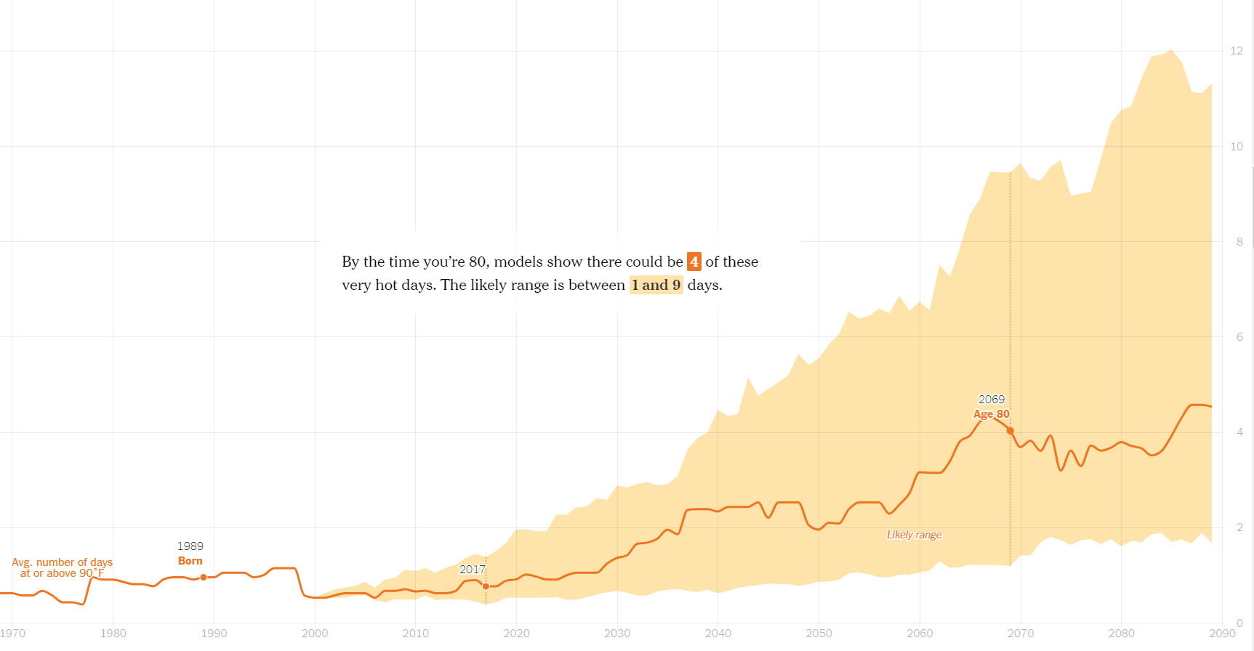

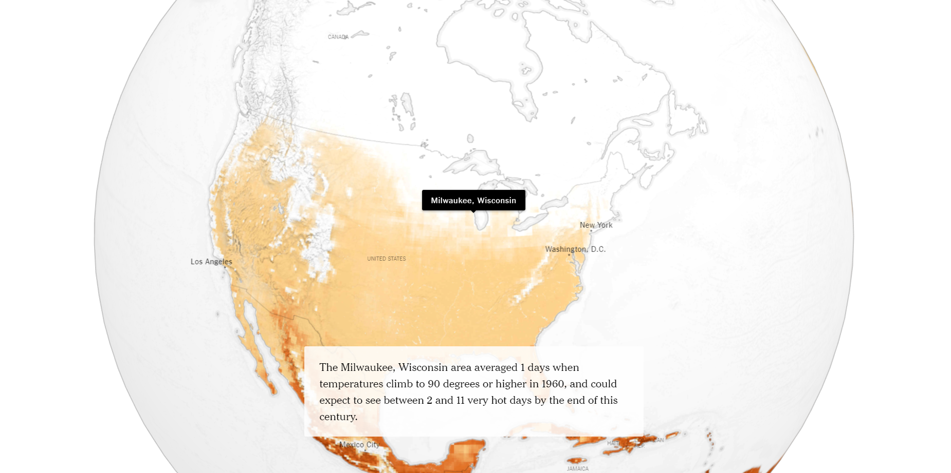
“How Much Hotter Is Your Hometown” (Outside Project)
https://www.nytimes.com/interactive/2018/08/30/climate/how-much-hotter-is-your-hometown.html
Notes:
NYTimes is an American daily newspaper based in New York City with a worldwide readership
Interesting approaches/features: scrollytelling, story “changes” based on input selection to tailor to reader, within-story widgets, fascinating data -> good story
https://www.nytimes.com/projects/2020-report/index.html
“The Times has an unparalleled reputation for excellence in visual journalism. We have defined multimedia storytelling for the news industry and established ourselves as the clear leader. Yet despite our excellence, not enough of our report uses digital storytelling tools that allow for richer and more engaging journalism. Too much of our daily report remains dominated by long strings of text.“
“When we ran a story in 2016 about the roiling debate over subway routes in New York, a reader mocked us in the comments for not including a simple map of the train line at the heart of the debate. Similarly, when we write about dance or art, our reporters and critics are able to include video or photography but only in a limited way; they lack the proper training to embed visuals contextually, and our content management system, Scoop, makes the placement of visuals an afterthought.”
“We also need to become more comfortable with our photographers, videographers and graphics editors playing the primary role covering some stories, rather than a secondary role. The excellent journalism already being produced by these desks serves as a model. Given our established excellence in this area, creating a more visual daily report is an enormous opportunity.”

Slide 6

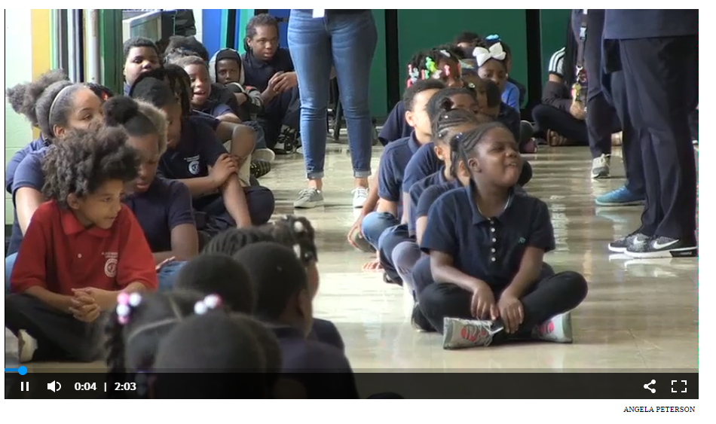

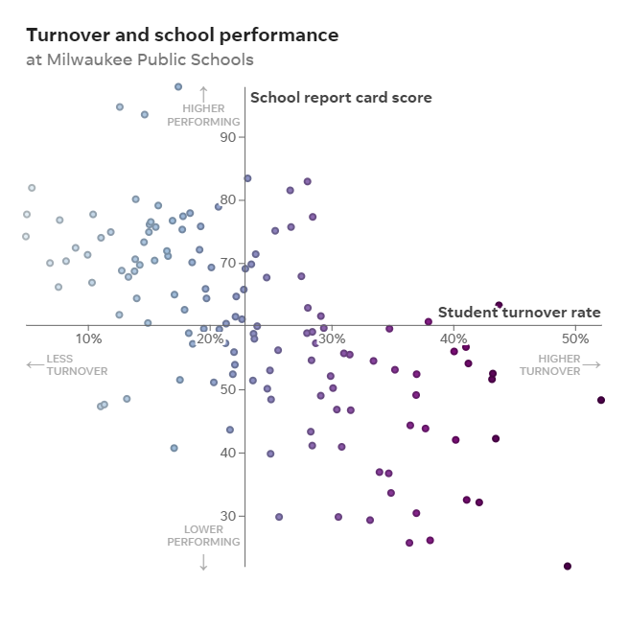
“Lessons Lost” (Outside Project)
https://projects.jsonline.com/news/2018/10/5/high-student-turnover-in-milwaukee-stalls-achievement-despite-reforms.html
Notes:
Milwaukee Journal Sentinel, Wisconsin’s most circulated newspaper (~40th in the country) published online and print series called “Lessons Lost.” It examines the academic impact of student turnover between schools in Wisconsin and across the nation. Won 2019 Online Journalism Award for Investigative Journalism, Small/medium newsroom (https://awards.journalists.org/entries/lessons-lost/)
Interesting approaches/features: scrollytelling, integration of video and photography, transitions between visuals, graph annotations
“We were able to obtain and analyze more than 12 million lines of student-level data for all of Wisconsin’s students over 13 years. We combined that with state test scores and school report card scores and showed the negative impact on achievement for students who moved – and how the churn is concentrated among the lowest performing schools in Milwaukee.
While the data work was extensive and challenging, we were determined to present it in a way that is accessible to readers, with data visualizations, narrative stories, searchable tables and more. Getting to the final product took sophisticated investigative reporting techniques, skilled data analysis and old-fashioned shoe-leather reporting.“

Slide 7
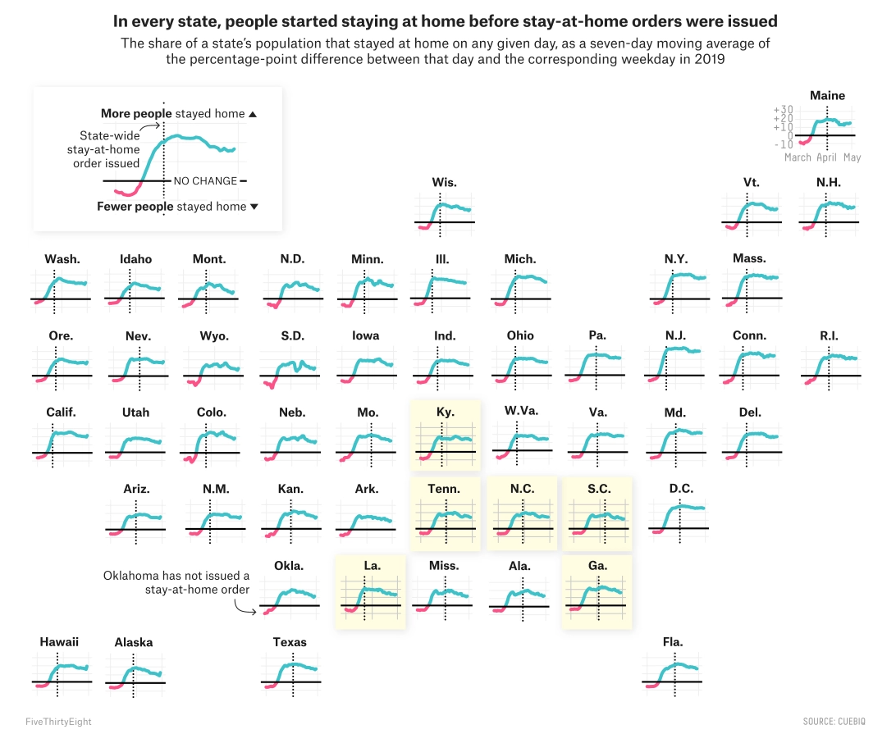

“Americans Didn’t Wait” (Outside Project)
https://fivethirtyeight.com/features/americans-didnt-wait-for-their-governors-to-tell-them-to-stay-home-because-of-covid-19/
Notes:
FiveThirtyEight is a digital publication of stories, charts, videos and interactive graphics – with a specific focus on data journalism. Specifically, the skill sets of their teams “include statistical analysis, but also data visualization, computer programming and data-literate reporting.”
https://fivethirtyeight.com/features/what-the-fox-knows/
Interesting approaches/features: simplicity, graph annotations. R and Adobe Illustrator are widely used within their staff for data exploration, analysis, and visualization prototyping.

Slide 8
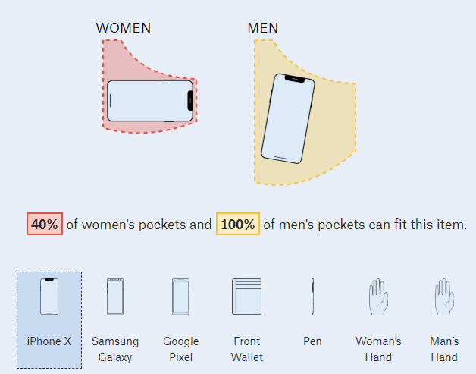

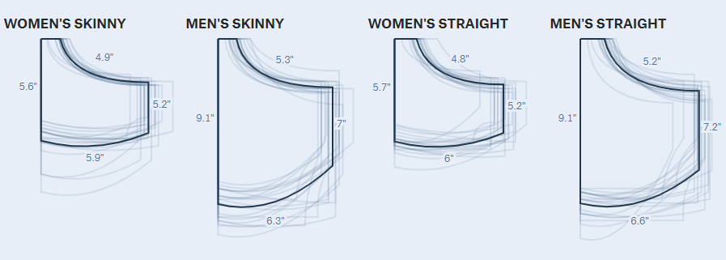
“Pockets” (Outside Project)
https://pudding.cool/2018/08/pockets/
Notes:
https://pudding.cool/about/#faq The Pudding is a digital publication comprised that seeks to explain ideas debated in culture with visual essays. They say “by wielding original datasets, primary research, and interactivity, [they] try to thoroughly explore complex topics... to advance public discourse and avoid media echo chambers.” Compared to the NYT, they describe themselves as a “building-the-plane-in-the-air type of organization” focused on the creative process than publication deadlines.
Interesting approaches/features: scrollytelling, within-story widgets, fascinating data -> good story

Slide 9
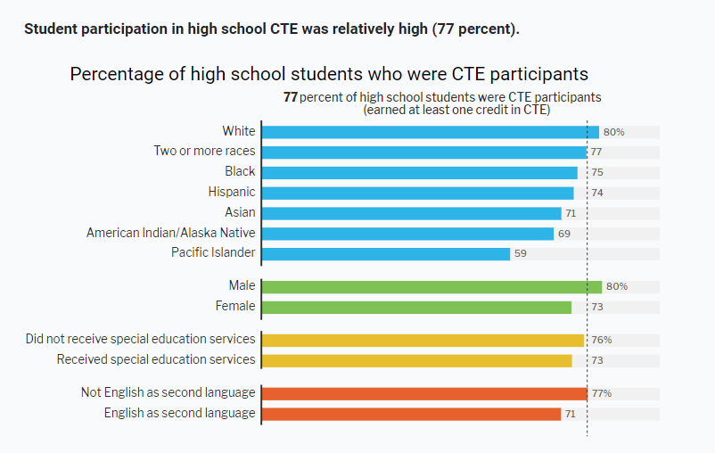

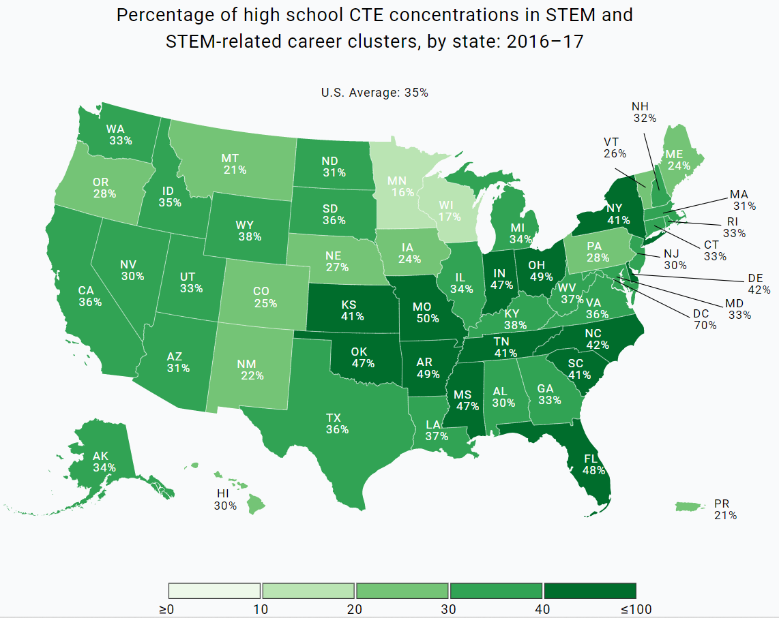
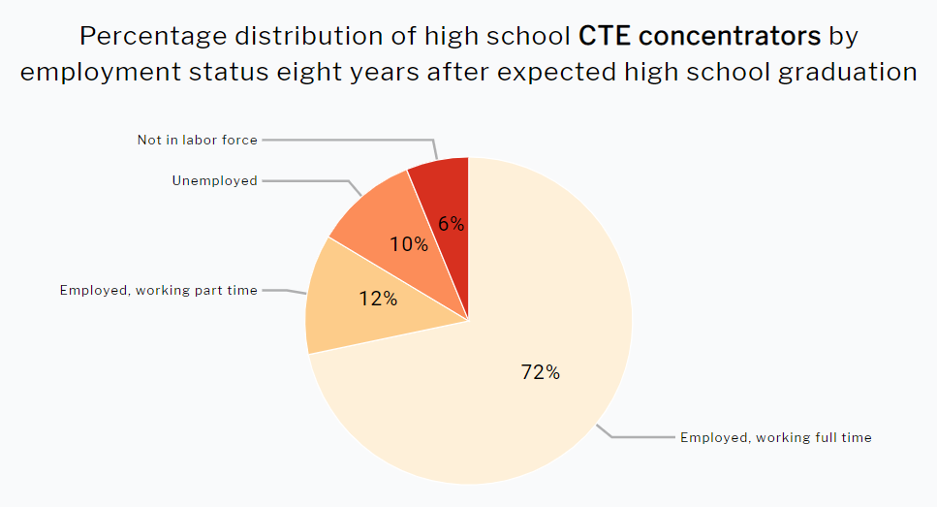
“Bridging the Skills Gap” (Production Support from AIR)
https://www2.ed.gov/datastory/cte/index.html
Notes:
Interesting approaches/features: download data/more information icons, bold titles are main takeaway from the visualiztions

Slide 10

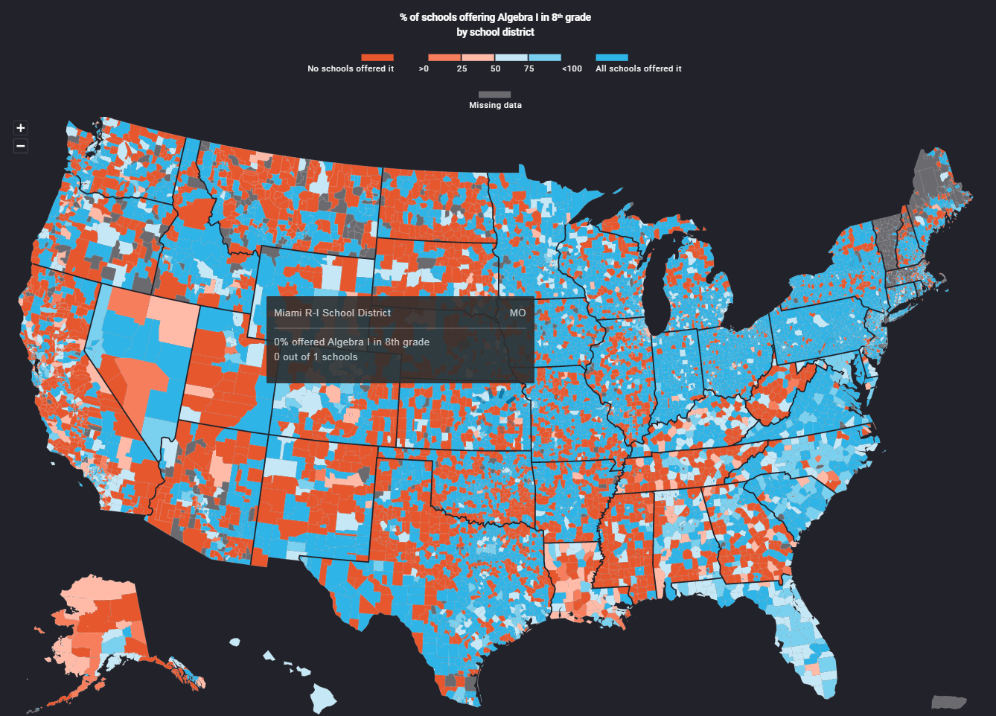
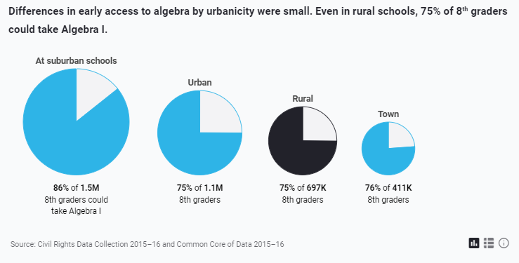
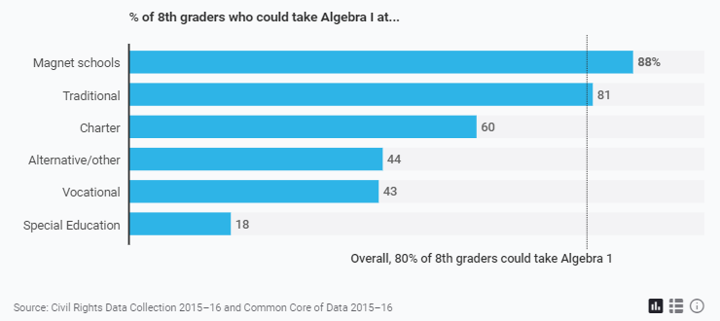
“A Leak in the STEM Pipeline” (Production Support from AIR)
https://www2.ed.gov/datastory/stem/algebra/index.html
Notes:
Interesting approaches/features: bar graph annotations, complex map interactivity

Slide 11
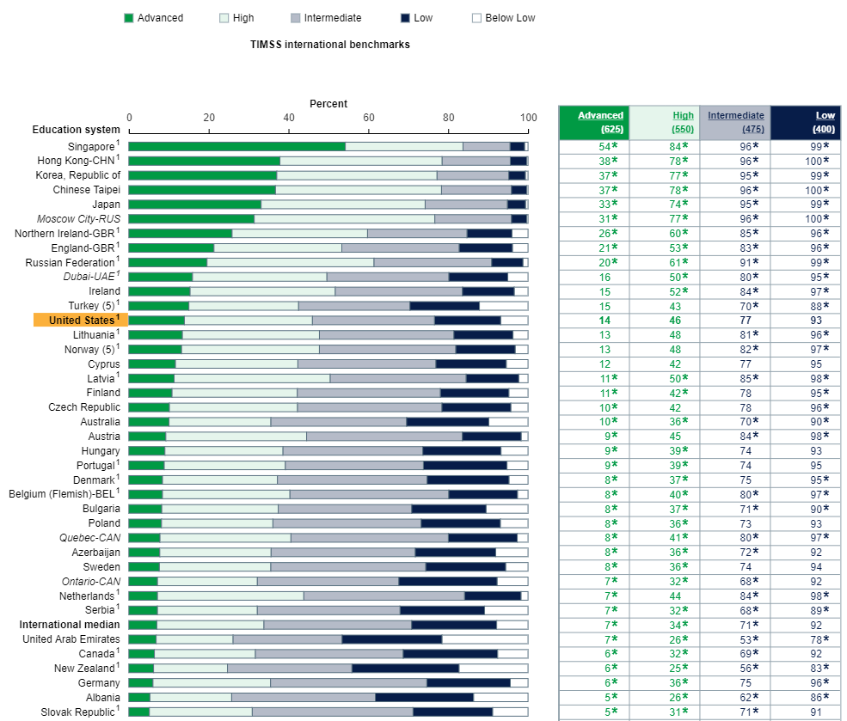

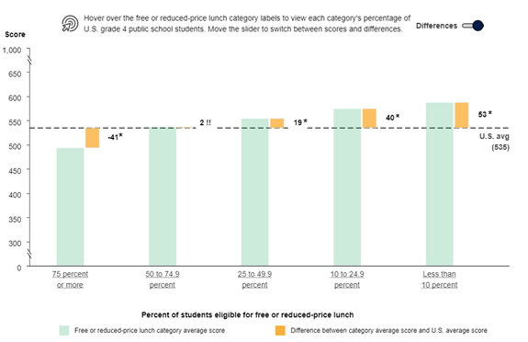
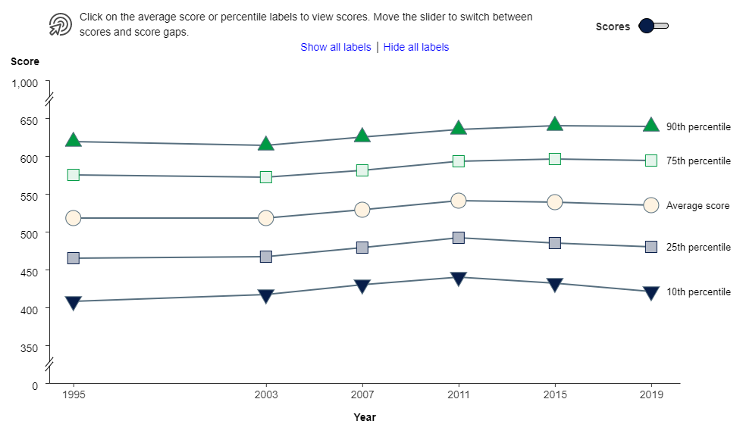
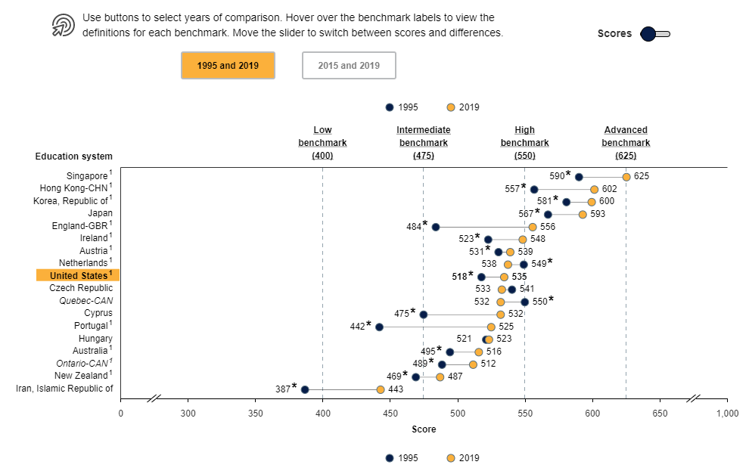
TIMSS 2019 Results (Production Support from AIR)
https://nces.ed.gov/timss/results19/index.asp
Notes:
Interesting approaches/features: densely populated figures/tables, complex annotations controlled by a switch, sticky navigation on left provides ability to jump between G4/G8 results

Slide 12
Activity One: What Makes an Effective Data Story?
Find a data story of interest (either now or from the pre-session activity) and consider what features or approaches make it an effective data story.
Discuss with your group and be prepared to share with everyone!
Notes:
NOTE BEFORE BREAKING: the breakout rooms may not be able to track the notes you take upon returning to the whole group. You are encouraged to take notes on your machine

Slide 13
Data Story Process

Slide 14
Recommended Data Story Process
1. Concepting
Summary of critical report
Audience
Storyboarding (shaping the format of data visualization)
2. Development
Wireframe for layout, formatting, and UX/UI
Data prep for visualizations
Web app development
4. Production
Final testing for complying with web standards, usability, and accessibility
Move development environment to live site
3. Review*
Internal Review
Revisions from Internal Review
Client Review
Revisions from Client Review
* There can be multiple rounds of each kind of review depending on team, project, budget, etc. Effective production usually includes 3-4 rounds with a blend of these kinds of review.

Slide 15





Meet the Team
Review
Client
Graphic Designer
Web Developer
Content Experts/
Researchers
Data Developer
Development

Slide 16
Meet the Team Skills
Graphic Design
Web Development
Content Expertise/
Research
Data Development

